Slide 1
A Qualitative and Quantitative Requirement Engineering Analysis of MoReq2010
Ricardo Vieira*; Guilherme Gaspar; José Borbinha

Slide 2
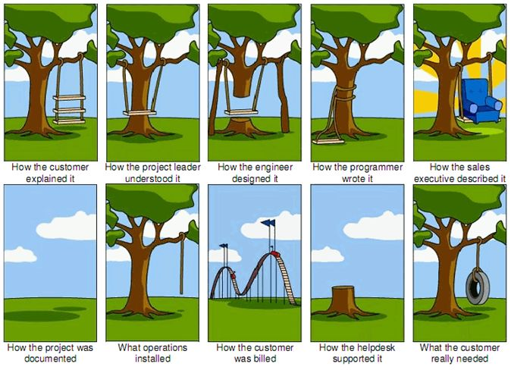
Requirement Engineering

Slide 3
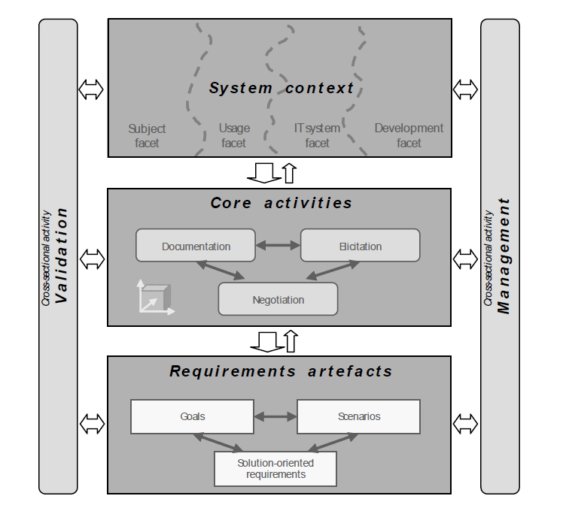
Requirement Engineering Framework by Klaus Pohl

Slide 4
Core Activity - Documentation
Structure
  Specification
  Requirements
Content
  Requirements
    Well-expressed Qualities

Slide 5
Structure – Use standard structure guidelines
Proven structure by RE experts;
Easy to check if information is missing;
Focus on content;
Information always in the same place;
Several tools already exist.

Slide 6
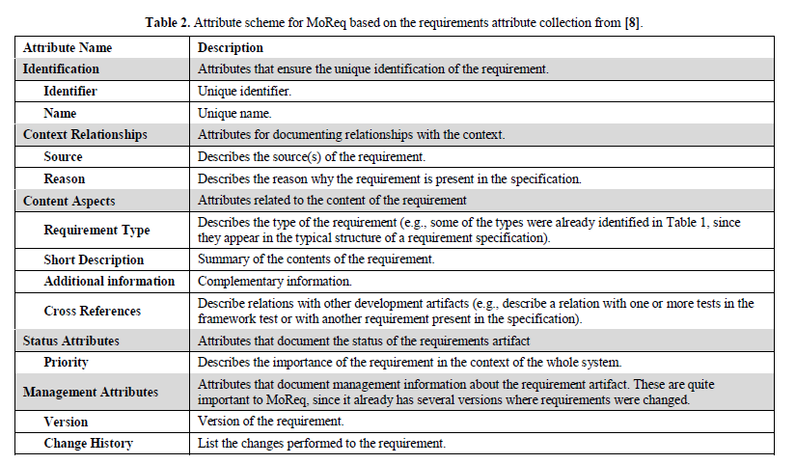
Structure - Requirements Attribute

Slide 7
Advantages of Requirements Attributes
Template of attributes define essential information;
Easy to check missing information;
Easy to use, check and search information facilitating requirement analysis and validation;
Easy to filter information using attributes.

Slide 8
Content – Requirements Quality
Complete
Traceable
Unambiguous
Clear
Consistent
Atomic
Verifiable
Feasible
Abstract

Slide 9
Analysis of Requirement 8.4.14
“The MCRS must update the disposal status of any Record when requested by an authorised user and, either immediately or periodically, and at least daily, the MCRS must update the disposal status of all active records.”
  Non atomic
  Not clear
  Ambiguous

Slide 10
Quality Check Criteria
# Analysed Requirements: |  | 174
Quality | Check Criteria | # Rec | % FP
Complete | Search for words that indicate incompleteness ("not determined", "not defined", composed words) | 0 | 0%
Unambiguious | Search for ambiguos words (“significant”, “greater”, “easy”,…) | 21 | 14%
Clear | Search for word repetions (“and” e “or”) | 14 | 0%
 | Search for implicit references (“that”, “this”, “its”, “theirs”) | 102 | 39%
Atomic | Count words (up to 50 words) | 63 | 25%
# Recommendations (Rec) |  | 200 | 59

Slide 11
Identification of “Strong” Requirements

Slide 12
. Chapter Number Chapter Name |  | 2 | 3 | 4 | 5 | 6 | 7 | 8 | 9 | 10 | 11 | Dependecy % | # of References | # of Dependables
System Services | 2 | 38 | 1 | 0 | 0 | 1 | 5 | 3 | 0 | 1 | 3 | 50% | 52 | 28
User and Group Service | 3 | 6 | 5 | 1 | 0 | 0 | 0 | 0 | 0 | 0 | 0 | 50% | 12 | 14
Model Role Service | 4 | 9 | 2 | 4 | 0 | 0 | 0 | 0 | 0 | 0 | 0 | 73% | 15 | 15
Classification Service | 5 | 1 | 0 | 0 | 2 | 1 | 0 | 1 | 0 | 0 | 0 | 34% | 5 | 8
Record Service | 6 | 4 | 0 | 0 | 0 | 16 | 0 | 1 | 0 | 0 | 0 | 23% | 21 | 21
Model Metadata Service | 7 | 8 | 0 | 0 | 0 | 0 | 24 | 0 | 0 | 0 | 0 | 40% | 32 | 20
Disposal Scheduling Service | 8 | 1 | 0 | 0 | 4 | 8 | 4 | 45 | 1 | 0 | 0 | 75% | 63 | 24
Disposal Holding Service | 9 | 2 | 0 | 0 | 0 | 0 | 0 | 1 | 3 | 0 | 0 | 43% | 6 | 7
Searching and Reporting Service | 10 | 2 | 2 | 0 | 0 | 0 | 0 | 0 | 0 | 36 | 0 | 15% | 40 | 27
Export Service | 11 | 2 | 0 | 0 | 0 | 0 | 0 | 0 | 0 | 0 | 21 | 20% | 23 | 10
Total |  | 73 | 10 | 5 | 6 | 26 | 33 | 51 | 4 | 37 | 24

Slide 13
Conclusions
Results are indicators. Not facts!
Motivates the importance of RE.
Global view of good indicators versus bad indicators;

Slide 14
Requirements Management Tool

Slide 15
Requirements Management Tool
Developers

Slide 16
Requirements Management Tool
Clients
Suppliers
Managers
Students
Potential Clients
Developers
Experts (IT, Records, Archival)
Translators

